Slide 1
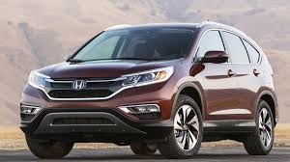
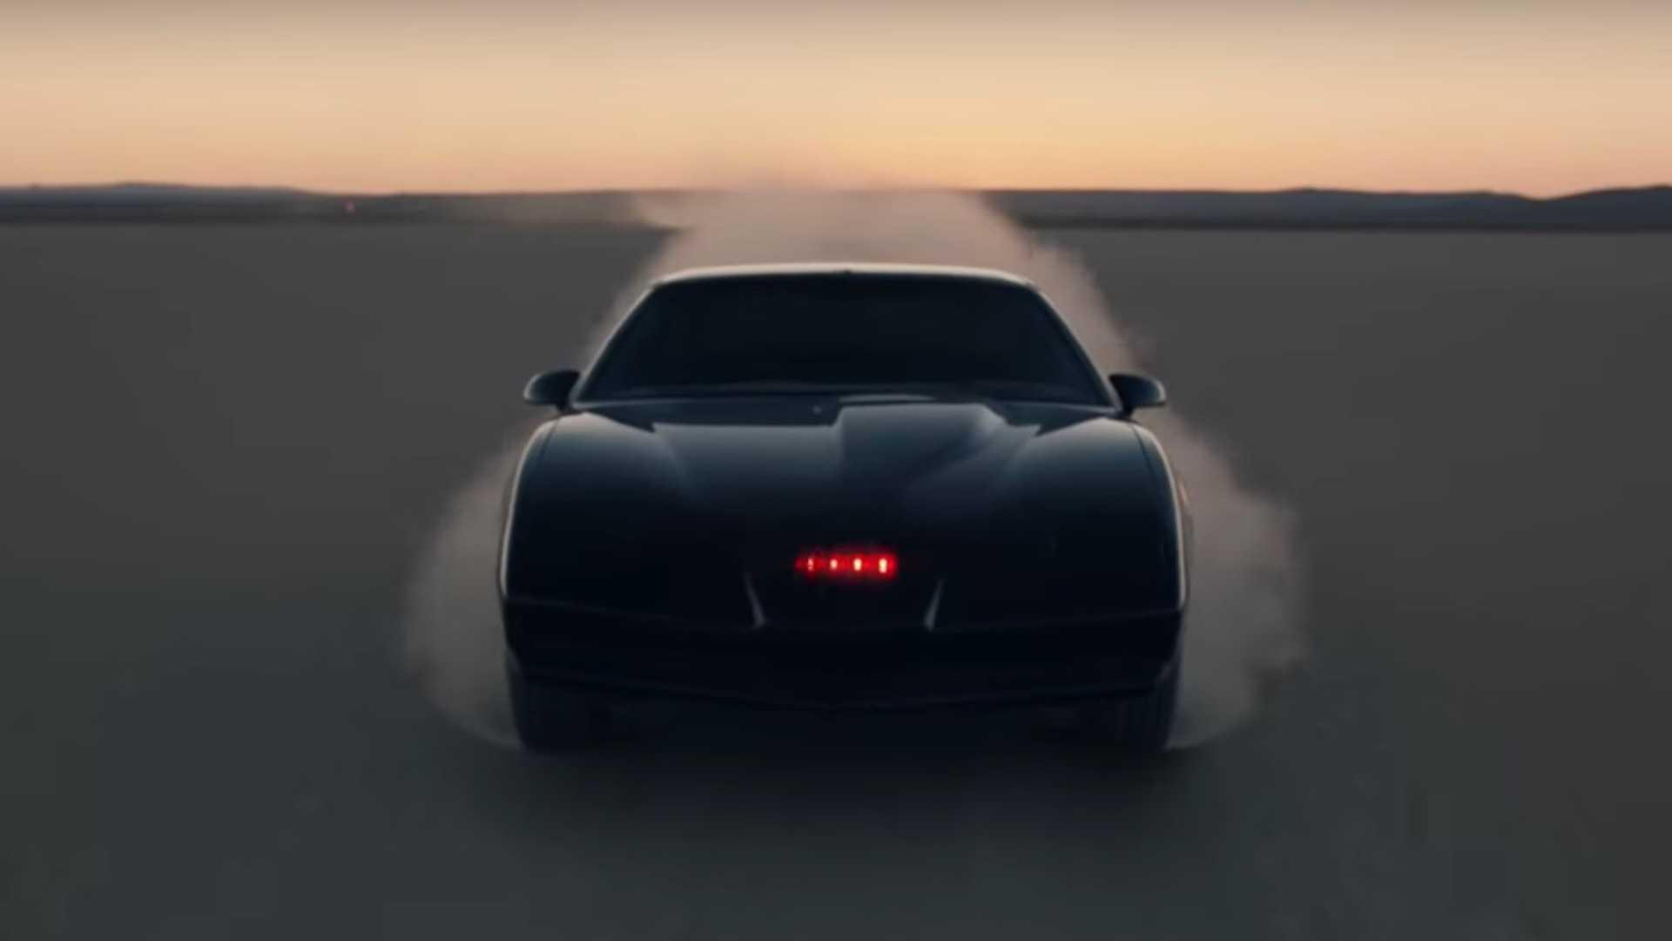
Classification of Cars via Neural Network, Runtime, and Accuracy Analysis
By: John Kim & Jeremy Ronquillo

Slide 2
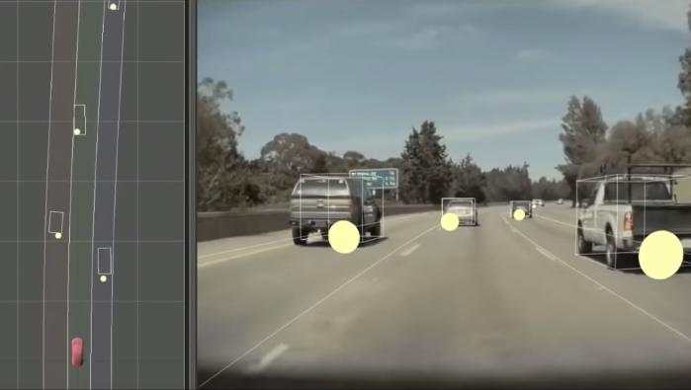
Background
Hands-free driving technology available on luxury cars.
Complete autonomous driving is on the rise!
These automations utilize neural networks to detect surrounding cars, pedestrians, objects, etc.
Image: Telsa Autonomy Day 2019 - Full Self-Driving Autopilot Investor Conference Event

Slide 3
Implementation
Convolutional neural networks
Keras
Image processing
Cv2
Data manipulation
Pandas DataFrame
Notes:
Your implementation. (bulk of your talk ~6 minutes)

Slide 4
Convolutional Neural Networks
2 Convolutional layers - 64 filters each
To reduce the number of free parameters in the network
Dropout filter - 25% for convolution layers & 40% for dense layers
Regularizing filter to prevent overfitting
Max pooling layer - 2x2 matrix
Reduce dimensionality of data
Dense layer - output arrays of shape (*, 256)
Linear operations that connects the input to the output by respective weights
Output layer - output arrays of (*, 49)
Final layer of neural network (predicts class)
Notes:
Convolutional layer:
A layer that consists of a set of “filters”. The filters take a subset of the input data at a time, but are applied across the full input (by sweeping over the input). The operations performed by this layer are still linear/matrix multiplications, but they go through an activation function at the output, which is usually a non-linear operation.
Pooling:
Pooling layers reduce the dimensions of the data by combining the outputs of neuron clusters at one layer into a single neuron in the next layer.
uses the maximum value from each of a cluster of neurons at the prior layer.
Normalisation layer:
Used at the input for feature scaling, and in batch normalisation at hidden layers.

Slide 5
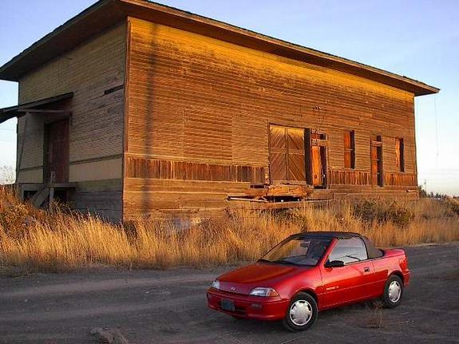
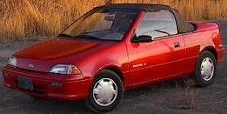
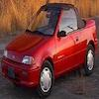
Data Cleaning
For all images:
Image Cropping
Image Scaling
25x25 pixels to 200x200 pixels
Cropped Image
Scaled Image
100 x 100 pixels
Original Image

Slide 6
Results - Run Configurations
Training rate
0.8
Image scaling (width x height)
25 x 25 pixels
50 x 50 pixels
…
200 x 200 pixels
Epoch (training phase iterations)
30
Executed on University of the Pacific’s ECS Cluster
Notes:
https://docs.google.com/spreadsheets/d/1DRiOYg1ZeCZvQ548uZrc4BgvUXY4dHrFw7OPvXHcOIY/edit#gid=0

Slide 7
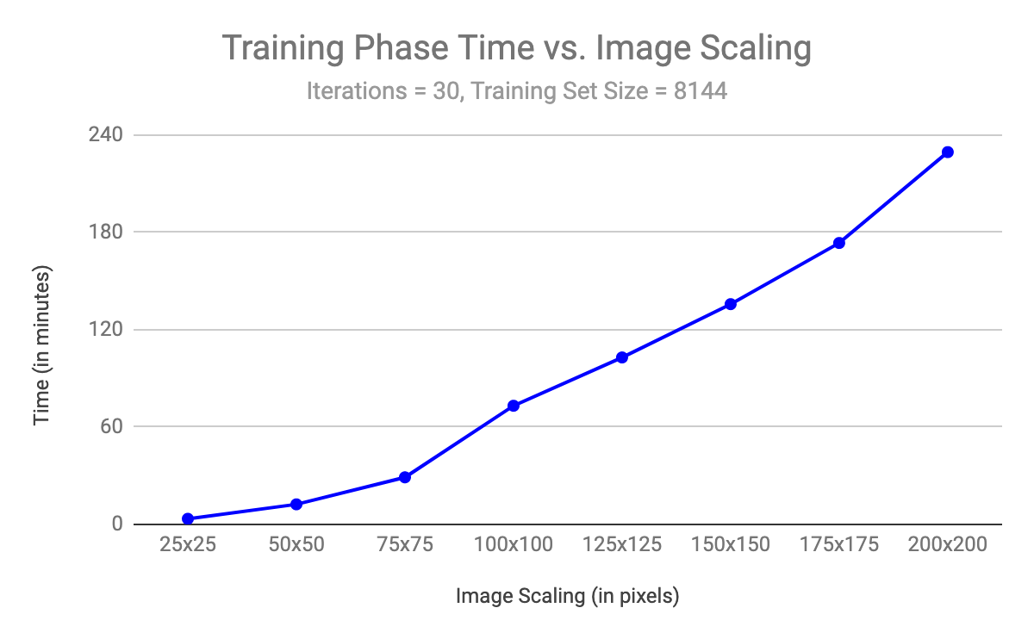
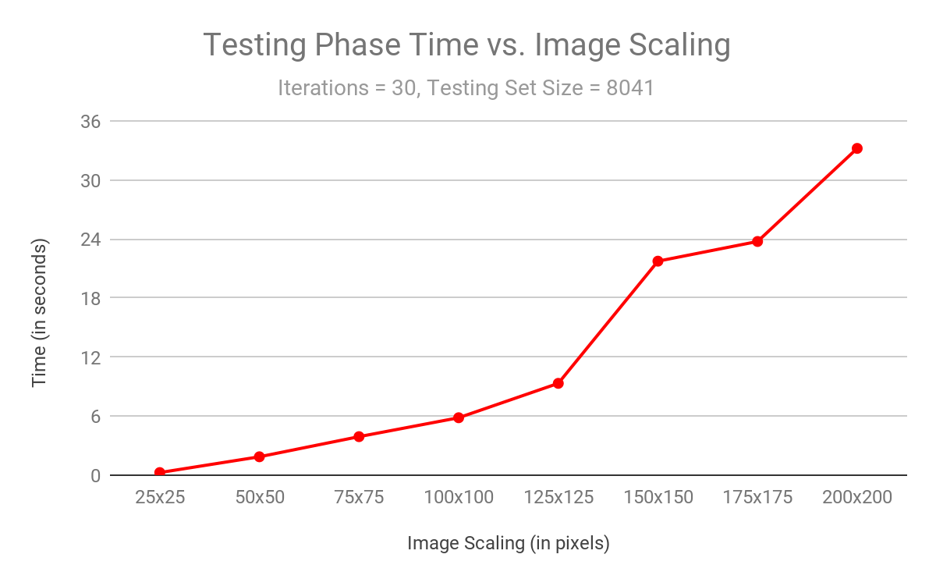
Results - Training & Testing Runtimes
Notes:
see https://docs.google.com/spreadsheets/d/1DRiOYg1ZeCZvQ548uZrc4BgvUXY4dHrFw7OPvXHcOIY/edit#gid=0

Slide 8
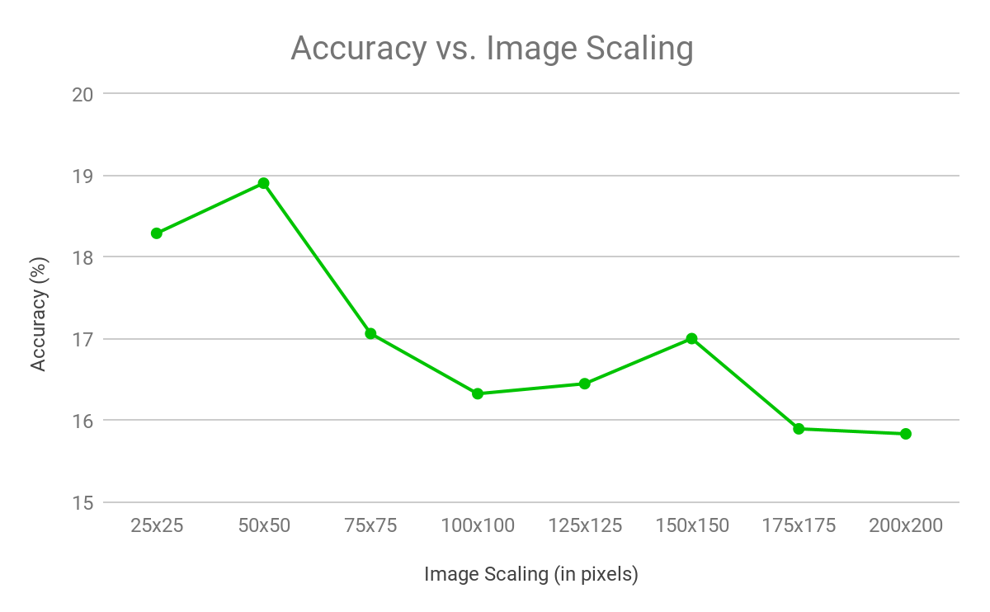
Results - Accuracy
Notes:
see https://docs.google.com/spreadsheets/d/1DRiOYg1ZeCZvQ548uZrc4BgvUXY4dHrFw7OPvXHcOIY/edit#gid=0

Slide 9
Conclusion
There just isn’t enough time!
Training a large dataset of high resolution images takes a very long time.
Testing on high resolution images also takes a while.
More iterations lead to accurate results, but also take more time.
Improvements:
GPU acceleration
Varying # training iterations
Detection of other objects
Notes:
Results and Conclusions. (Hit main points and wrap it well). (~ 2 minutes)

Slide 10
References
Cars Dataset:
http://ai.stanford.edu/~jkrause/cars/car_dataset.html
Keras Tutorial: https://elitedatascience.com/keras-tutorial-deep-learning-in-python#step-1

